Slide 1
A Full Day of PowerShell
Chrissy Lemaire, Rob Sewell and Jaap Brasser
@cl @sqldbawithbeard @jaap_brasser

Slide 2
A Full Day of PowerShell
PowerShell, Azure & SQL Server

Slide 3


About_Chrissy
SQL Server since 1999 & PowerShell since 2005
System Center Cloud and Datacenter Management MVP since 2015
DBA with General Dynamics IT at NATO Spec Ops HQ in Belgium
@cl on Twitter
Blogs at netnerds.net
Also RealCajunRecipes.com
Lead for the Belgian PowerShell User Group
Co-Lead for SQL PASS PowerShell Virtual Chapter
@cl

Slide 4

About_Rob
Name : Rob
Occupation : DBA, Automator
Website : sqldbawithAbeard.com
Twitter : @sqldbawithbeard
Interests : PowerShell, Automation And SQL (PaaS geddit?)
Interesting Fact : Has a Beard. (Still) Plays Cricket
Speaker : SQL Saturdays, SQL Relay, PowerShell Conference EU
Community : SQL South West , SQL Saturday Exeter , PowerShell Virtual Chapter, Organiser for PowerShell Conference EU 2017, Officer, Lead for dbareports, contributor to dbatools
@sqldbawithbeard

Slide 5

About_Jaap
Dutch PowerShell User Group
Blogging
PowerShell Magazine
JaapBrasser.com
Slack
Reddit
GitHub
PowerShell Gallery
TechNet Forums/Gallery
@Jaap_Brasser

Slide 6
Agenda for Today
PowerShell: The beginning
Defining variables
Basic script structure
Loops, operators and flow control
Advanced PowerShell functionality
PowerShell tips from the field

Slide 7
PowerShell: the beginning

Slide 8

What is PowerShell and how did it start
Development started in 2001
First released in 2006
Created by a team led by Jeffrey Snover
Was initially codenamed Monad
It is written: PowerShell

Slide 9
PowerShell naming convention
Verb-SingularNoun
Verb has to be ‘approved’
Noun should be descriptive, can contain a prefix

Slide 10

How to read the PowerShell language

Slide 11
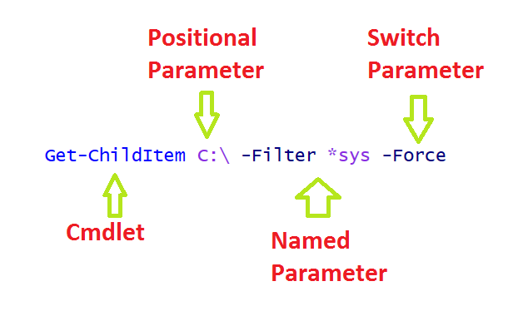
The PowerShell language

Slide 12
Demo – Get-Verb / Get-ChildItem
Get-Verb lists all approved verbs
If you omit a parameter name, PowerShell will use ‘positional parameter’

Slide 13

Question
What happens when you use a non-approved verb?

Slide 14
More PowerShell terms
Cmdlets
Functions
Aliases
External tools

Slide 15
PowerShell pipeline
Pipe using the pipe symbol: |
Output from one command can be passed on to the next
Transfers information using first out, first in

Slide 16
Demo – PowerShell help & pipeline
How to find help
Utilizing the PowerShell pipeline

Slide 17
Defining Variables

Slide 18
Define a variable in PowerShell
Using the ‘$Variable = …’ notation
Using the –Variable cmdlets
Using Tee-Object

Slide 19
Object types in PowerShell
Each value displayed in the console or stored in a variable has an object type
Get-Member can be used to reveal the object
Examples of object types:
String, Integer, Boolean, Array
File, Folder, Registry entry, ACL

Slide 20
Objects in PowerShell
Each object has set of properties & methods
These can be discovered by using Get-Member
It is possible for a property to have multiple sub properties
Methods are executed by using ( ) notation

Slide 21
Demo – Defining variables
Use different methods of creating variables
Access methods and properties on objects
Simple calculations in the PowerShell console

Slide 22
Question
What is another method of creating a variable in PowerShell?

Slide 23
The string is the thing
Expanding strings
“ ”
@” …. “@
Literal strings
‘ ’
@’ …. ‘@

Slide 24

Arrays and hash tables

Slide 25
Demo – Strings, arrays & hashtables
Use literal strings unless something needs to be expanded
Arrays can contain any type of object
Hash tables are used to define custom objects

Slide 26
Basic Script Structure

Slide 27
Best practices
Do not use aliases
Write useful comments
Do not use one-liners outside of console
Write ‘simple’ code if possible
Write multiple small functions instead of a do-it-all script

Slide 28
Demo – From bad to Better
Created a function
Wrote a comment
Did not use any aliases
Used the pipeline to filter and select the desired results

Slide 29
Question
What could be better?

Slide 30
Best practices
Make sure that your code only runs until you have the information you need
Use Error handling where appropriate
Use comment-based help

Slide 31
Demo – A different approach
Created a function
Wrote comment-based help
Used the error handling to stop processing after result is found

Slide 32
Operators, loops & Flow Control

Slide 33
Comparison operators
-eq
-ne
-gt
-ge
-lt
-le
-Like
-NotLike
-Match
-NotMatch
-Contains
-NotContains
-In
-NotIn
-Replace

Slide 34
Loops
Foreach () {}
For…
| ForEach-Object
Do {} while ()

Slide 35
Flow control
If – elseif – else
Switch

Slide 36
Demo – Strings, arrays & hashtables
Use literal strings unless something needs to be expanded
Arrays can contain any type of object
Hash tables are used to define custom objects

Slide 37
PowerShell: Advanced functionality

Slide 38
Demo – My first advanced function
Writing a function in PowerShell
Create a parameter block
Use comments
Create comment-based help
Set mandatory parameters
Enable pipeline support

Slide 39
Question
What is the advantage of writing a function over writing a question?

Slide 40
Demo – My first advanced function
Using SupportsShouldProcess
-WhatIf
-Verbose
-Confirm
ValidateSet to verify a set of possible arguments

Slide 41
PowerShell Tips from The Field

Slide 42
What would you like to see?
Fast folder size
[adsi] and [adsisearcher]
Powershell –command
Efficient loops in PS
Convert word doc to pdf
Check compression of zip
Check open folders
Change a drive letter
Copy untitled tabs clip
Create simple GUI
List non-admin shares
Rename a disk
Create OpenFileDialog
Query MSDN from PS
Test local credentials
List AD attributes in use
‘Special’ variables

